Slide 1

Project Tittle:Text Classification
Presented By_
Fahmida Tuj Farhana
ID: 210303020015

Slide 2
INTRODUCTION: Text Classification. It’s the process of categorising text into organised groups. By knowing about the working of How Text Classification Works, we can segment texts such as emails, web pages, or documents into predefined classes.
Importance: Helps filter spam, sort emails, classify reviews.
Objective: Build a model to classify SMS messages as spam or ham.

Slide 3
Data Processing:
Steps Performed:
Removed unnecessary columns
Converted labels to binary values (ham = 0, spam = 1)
Text cleaning:
Lowercasing
Removing punctuation
Stopwords removal
Tokenization
Lemmatization (if used)

Slide 4
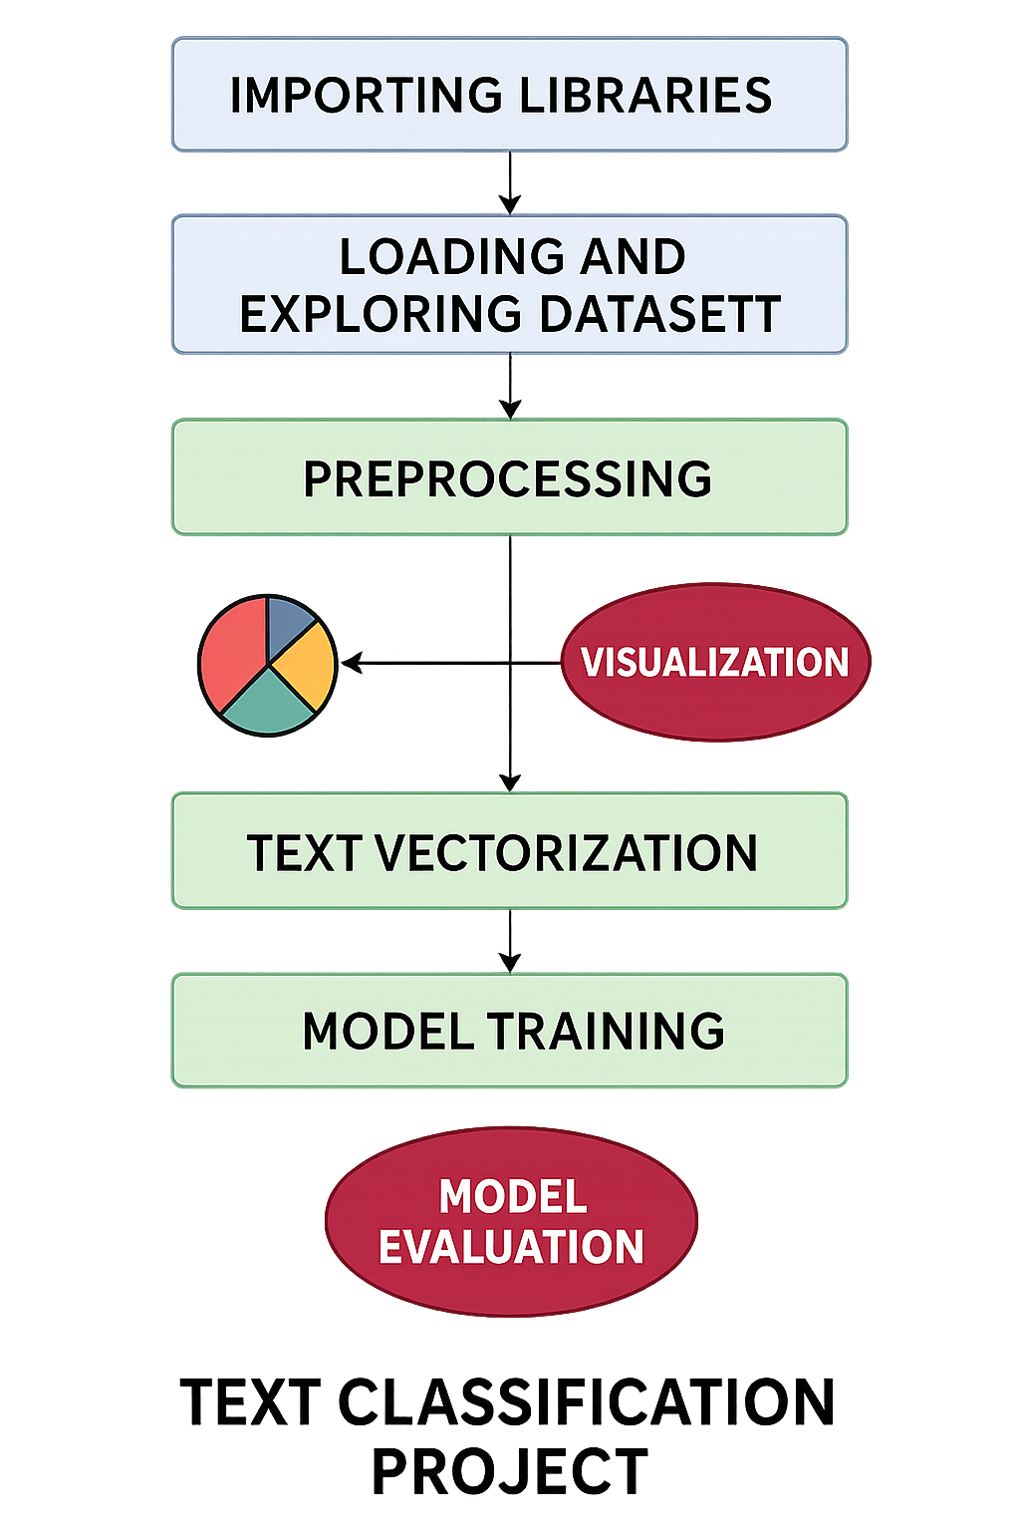
Flow Diagram

Slide 5
Exploratory Data Analysis
Visualizations Used:
Distribution of spam vs ham
Word clouds for spam and ham messages
Observations:
Ham messages are more frequent
Spam messages often contain words like "free", "win", "urgent"

Slide 6
Feature Extraction
Techniques Used:
Bag of Words (CountVectorizer)
TF-IDF (Term Frequency-Inverse Document Frequency)

Slide 7
Model Building
Algorithms Used:
Naive Bayes
Logistic Regression
Support Vector Machine (SVM)
Model Evalution
Evaluation Metrics:
Accuracy
Precision
Recall
F1-score

Slide 8
Conclusion
Built an efficient and accurate SMS spam classifier
Demonstrated successful real-world application of text classification

